Slide 1
FET

Slide 2
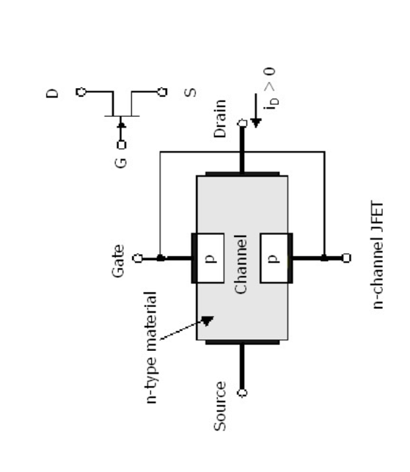
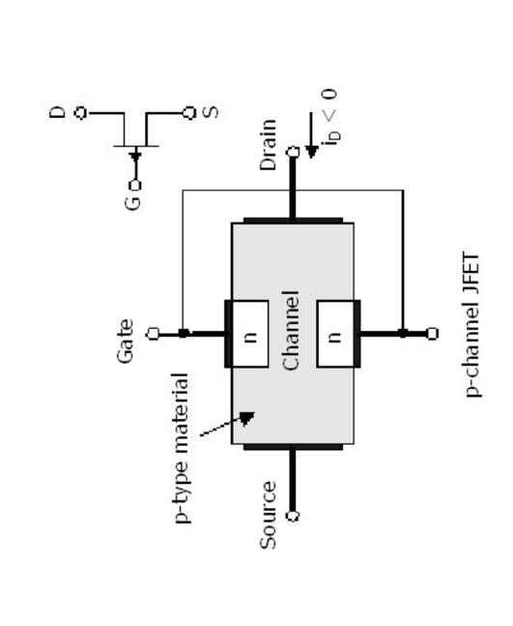
Junction Field Effect Transistor (JFET)

Slide 3
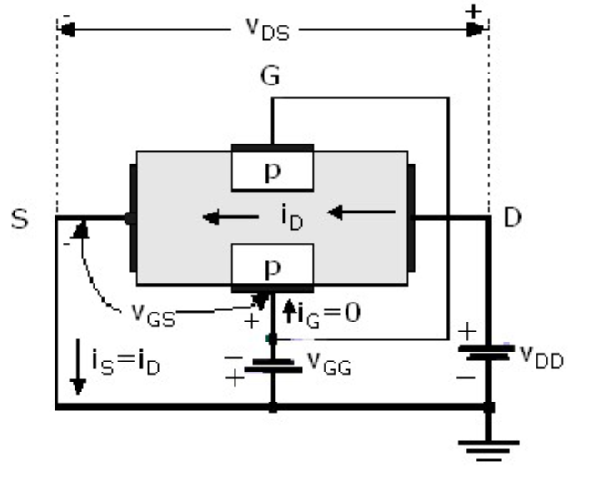
Operation

Slide 4
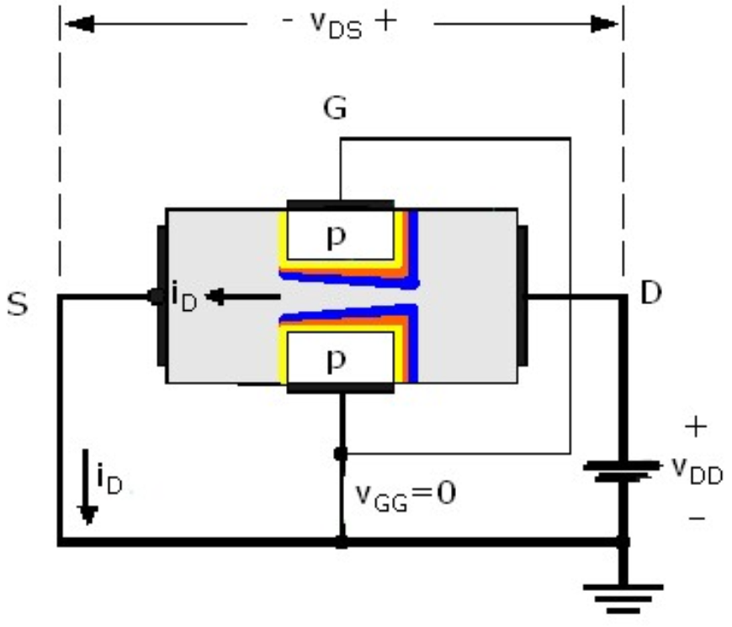
JFET Drain-To-Source Voltage Variation

Slide 5
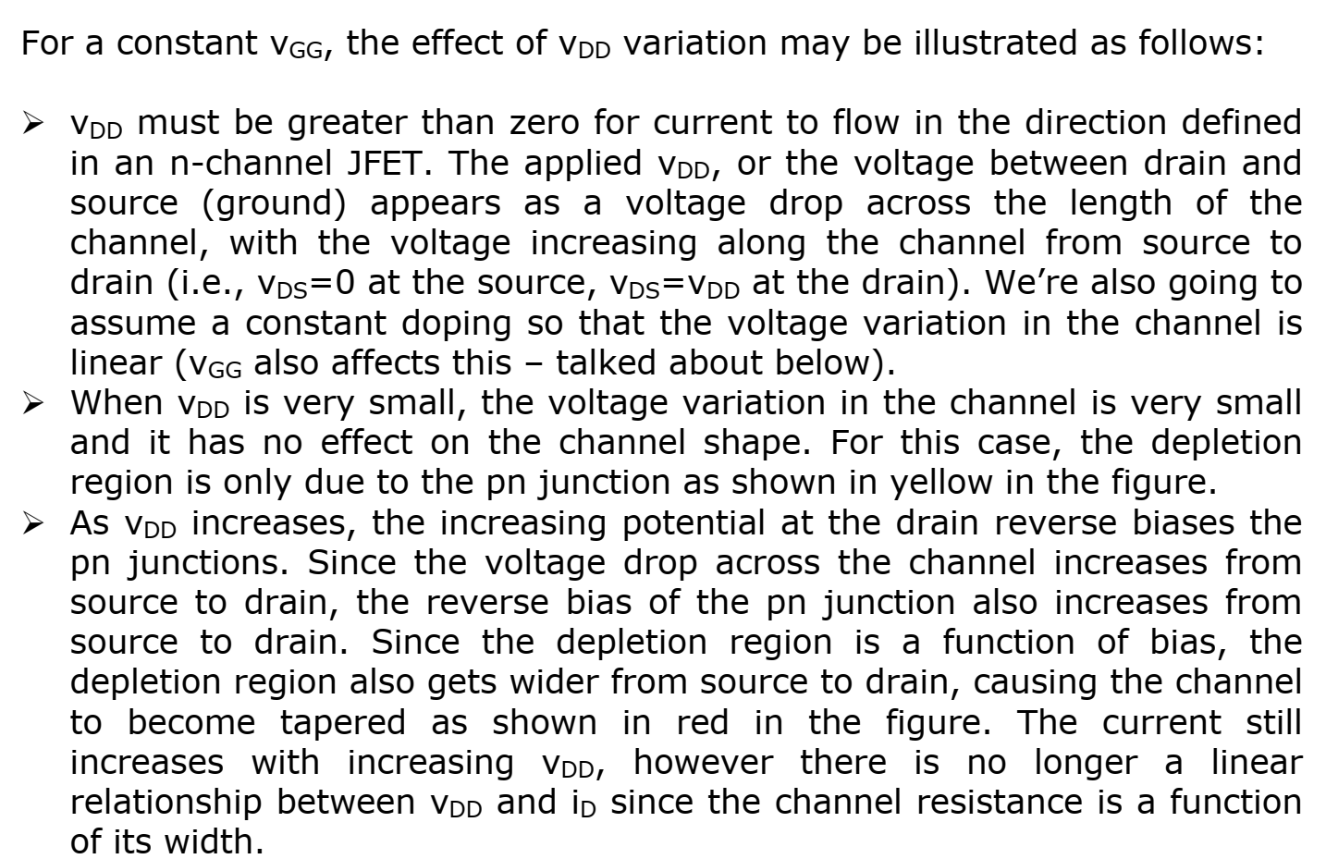

Slide 6
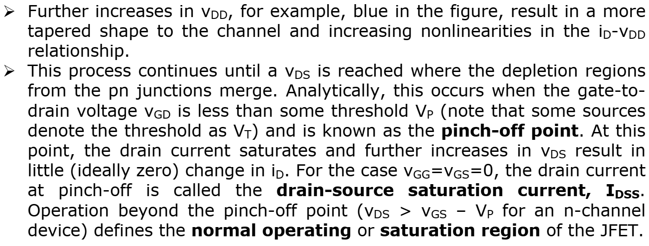

Slide 7
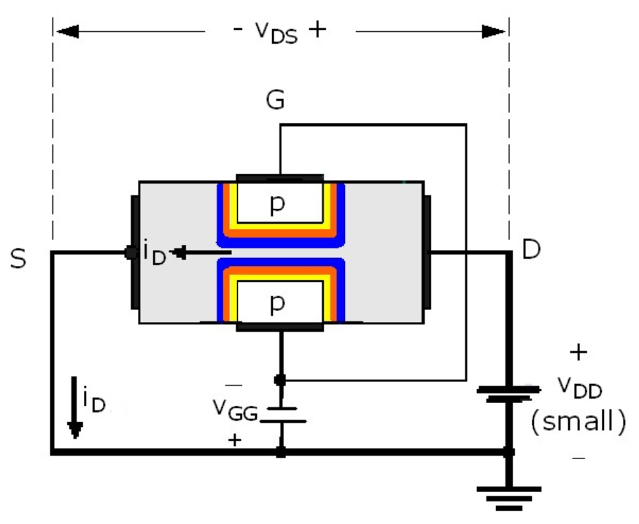
JFET Gate-To-Source Voltage Variation

Slide 8
For a constant v_{GG}, varying v_{DS} yields a single i_{D}-v_{DS} characteristic curve. To develop a family of characteristic curves for the JFET device, we need to look at the effect of v_{GS} variation. The figure to the right is a simple illustration of the variation of vGG with a constant (and small) v_{DD}. Recall from the previous discussion that, if vDD is small, v_{DS} is small and the channel width is essentially constant. In the figure, the increasing width of the pn junction depletion region (illustrated from yellow to red to blue), is due to the increasing reverse bias of the junction resulting from the application of a negative v_{GG} of increasing magnitude. As the depletion widths increase, the channel width decreases, resulting in a lower conductivity (higher resistivity) of the channel. As v_{GS} is made more negative (for an n-channel device), a value of v_{GS} is reached for which the channel is completely depleted (no free carriers) and no current will flow regardless of the applied v_{DS}. This is called the threshold, or pinch-off, voltage and occurs at v_{GS}=V_{GS}(OFF). The threshold voltage for an n-channel JFET is negative (V_{P} < 0, using your text’s notation)

Slide 9
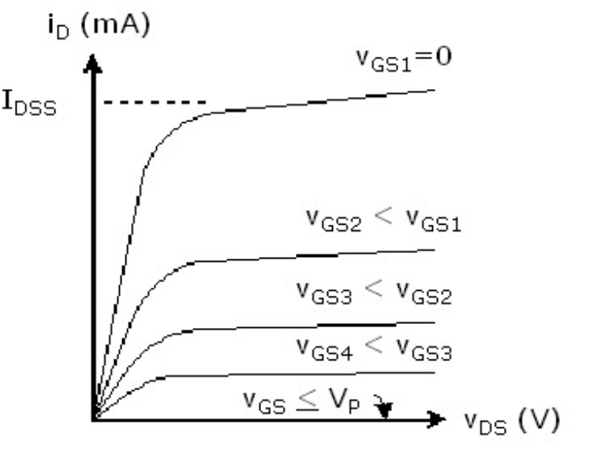
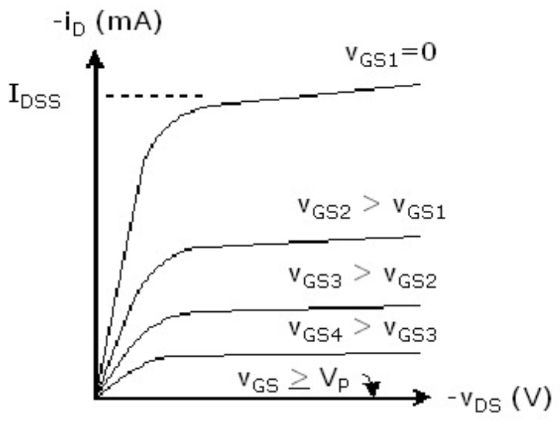
Characteristics
n- Channel
p- Channel

Slide 10
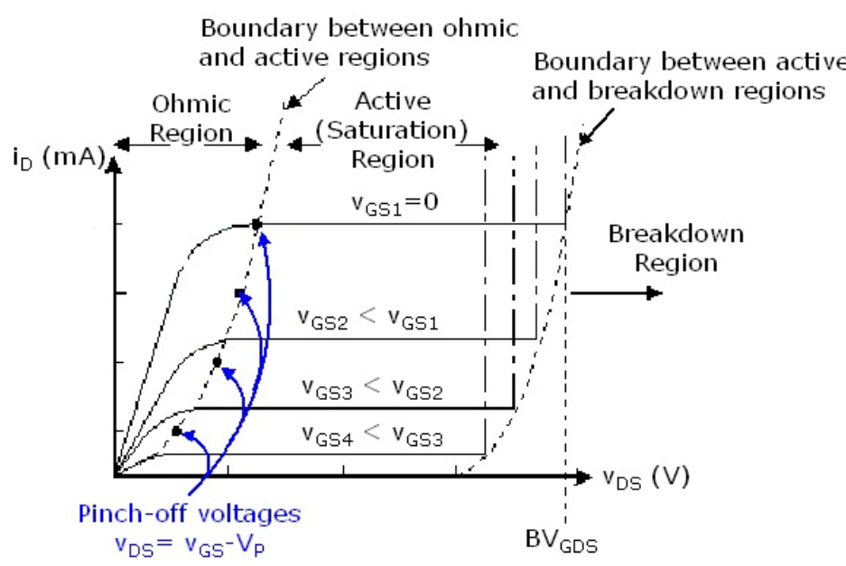
JFET Transfer Characteristics

Slide 11
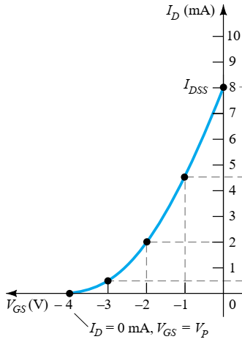
Transfer Characteristics

Slide 12
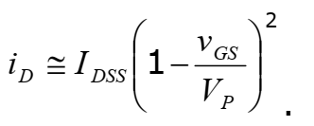
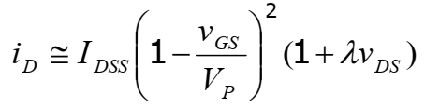
The drain current in the saturation region may be defined by using the Shockley equation in terms of the drain-source saturation current (IDSS), the threshold voltage (denoted VP in your text) and the applied gate-to-source voltage (vGS) as:
To account for the finite slope of the curves in the active region, the effect of a device parameter (λ), known as the channel length modulation parameter, that is analogous to the inverse of the BJT Early voltage (VA-1) is included in the expression for the drain current.
Usually, especially for large-signal analysis or biasing, λ is small enough that |λvDS| << 1.

Slide 13
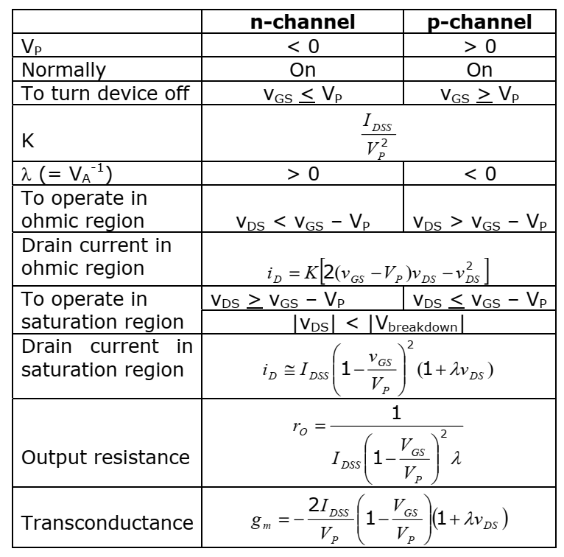
Summary of JFET characteristics:

Slide 14
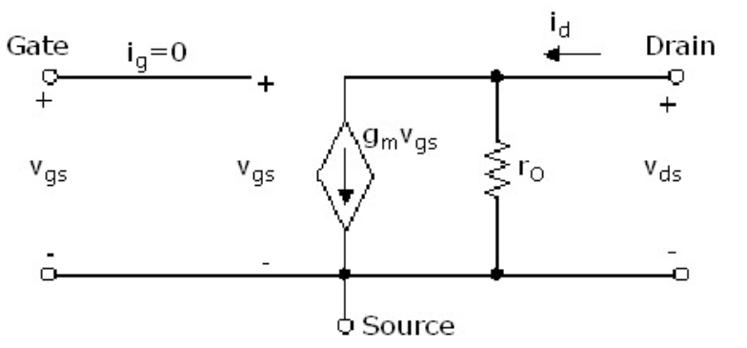
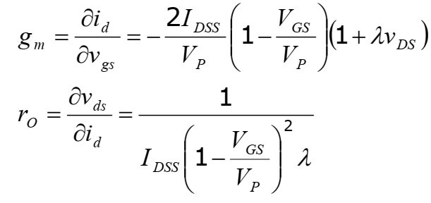
JFET Small-Signal Model

Slide 15
FET BIASING

Slide 16
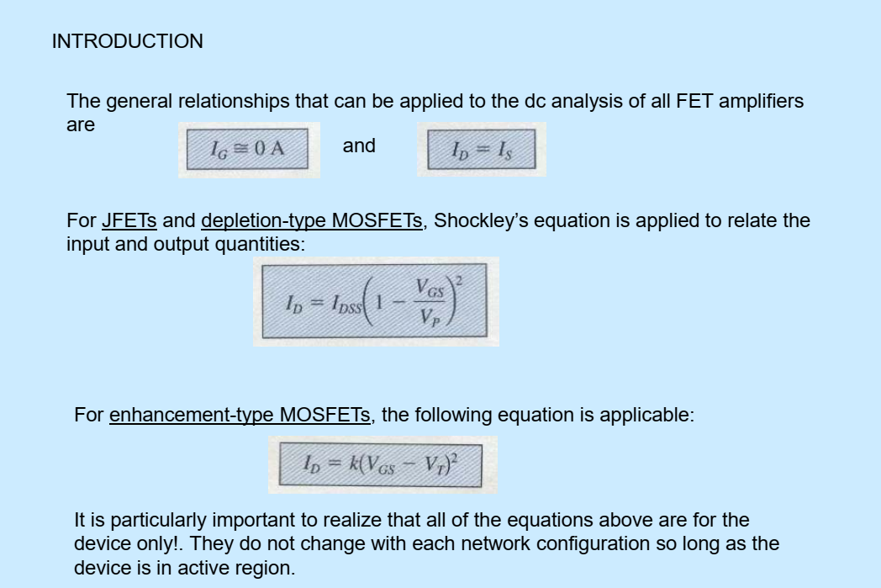

Slide 17
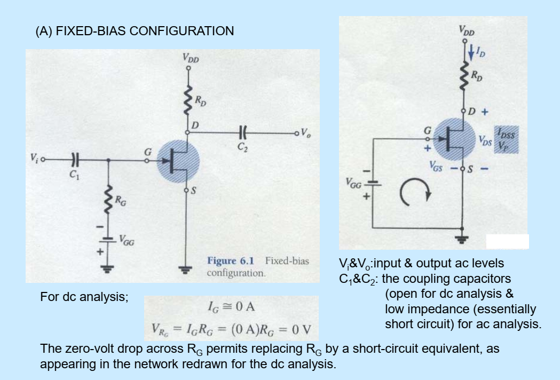

Slide 18
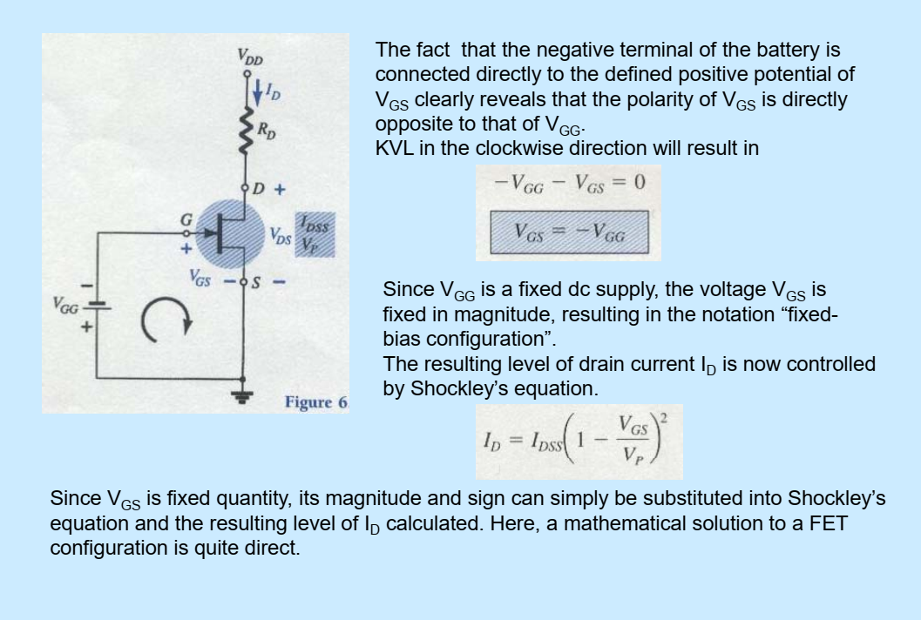

Slide 19
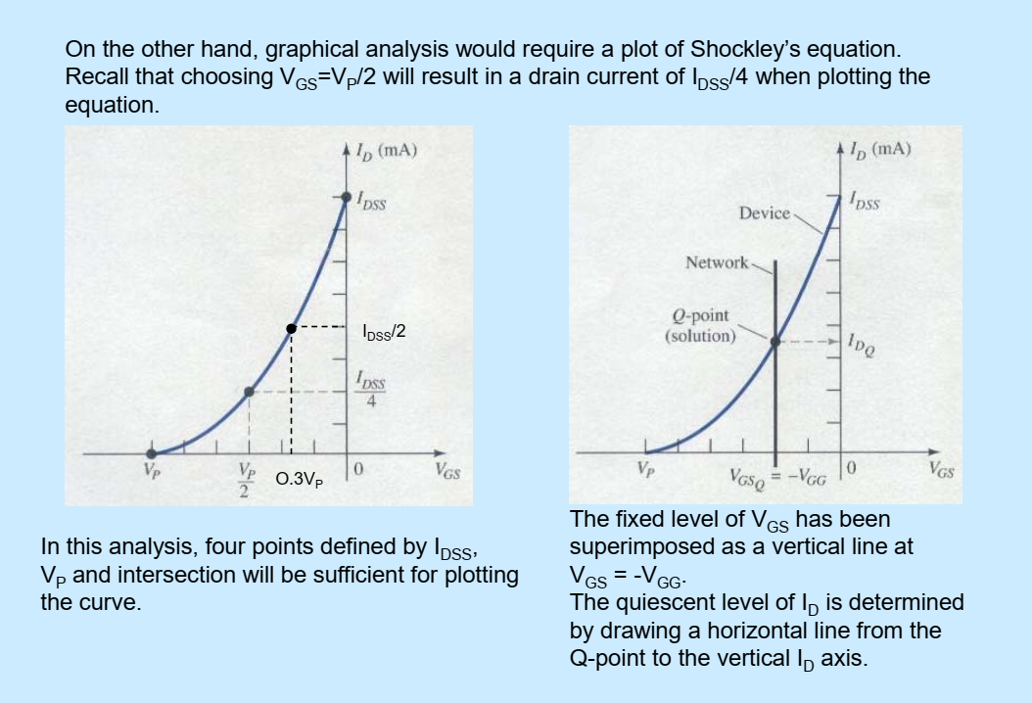

Slide 20
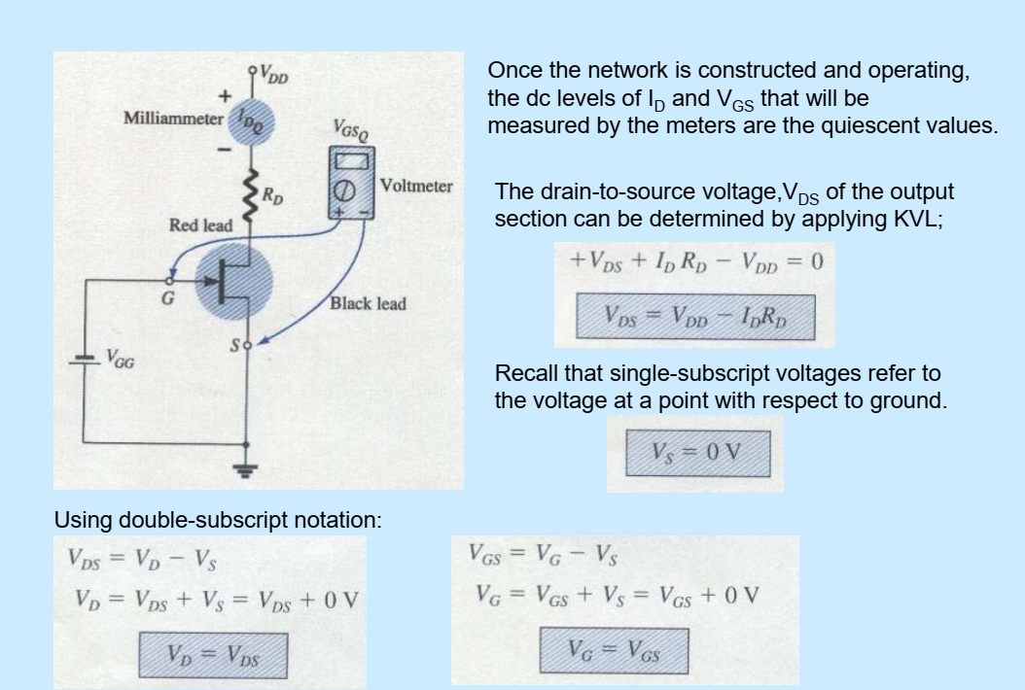

Slide 21
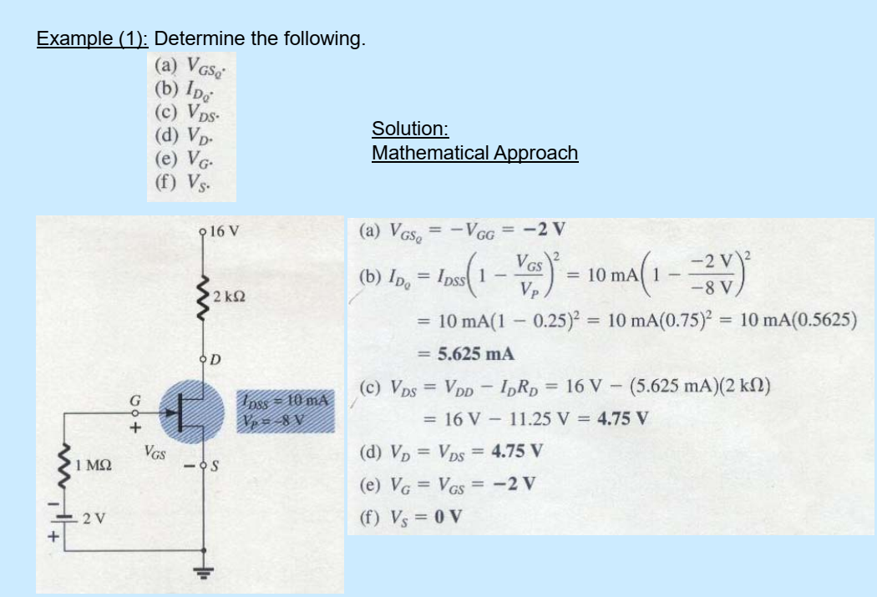

Slide 22
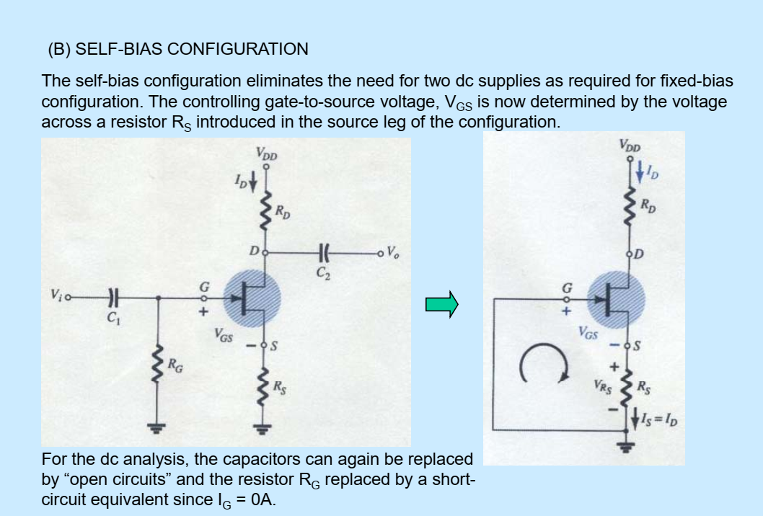

Slide 23


Slide 24
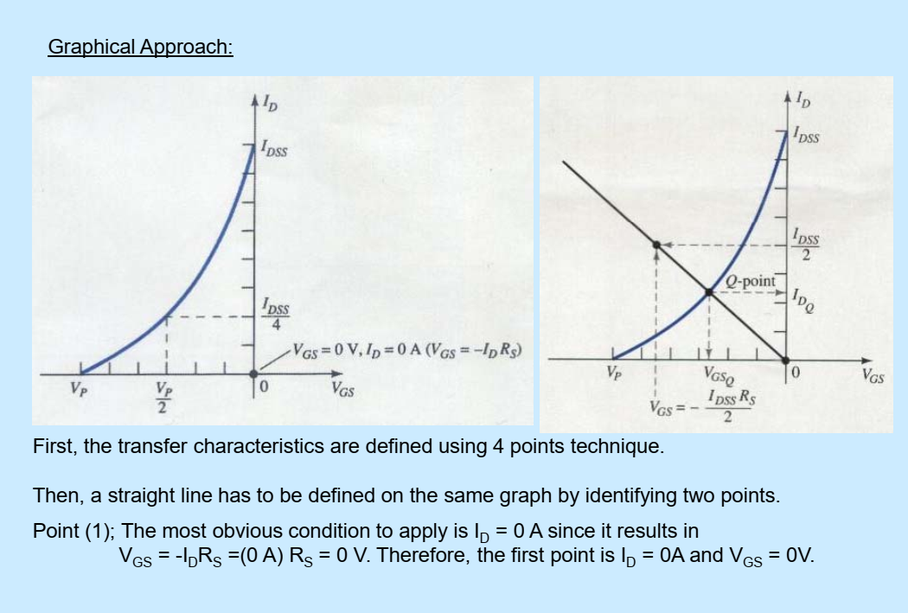

Slide 25


Slide 26
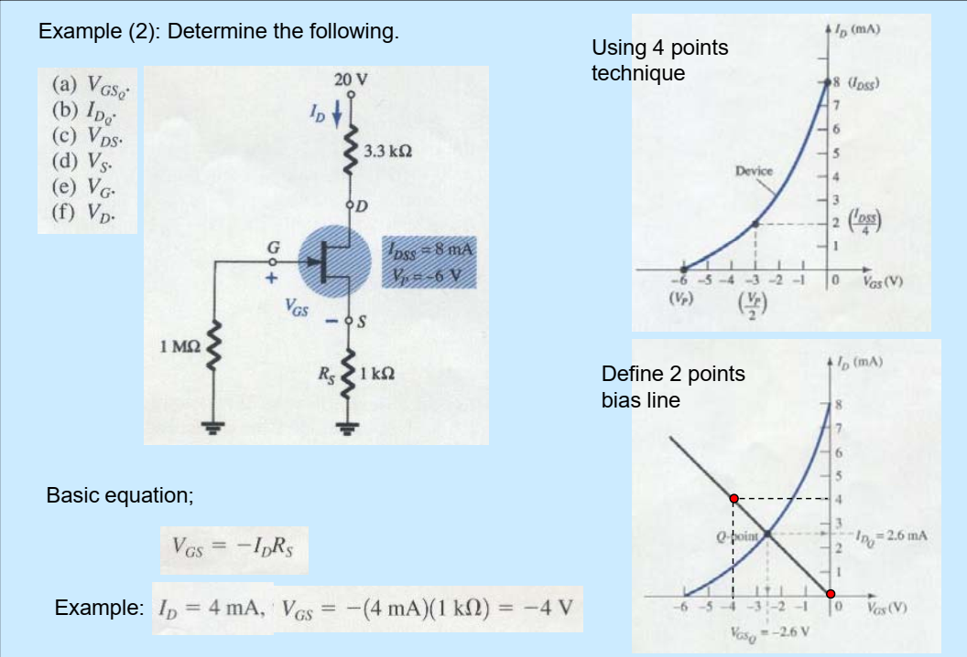

Slide 27
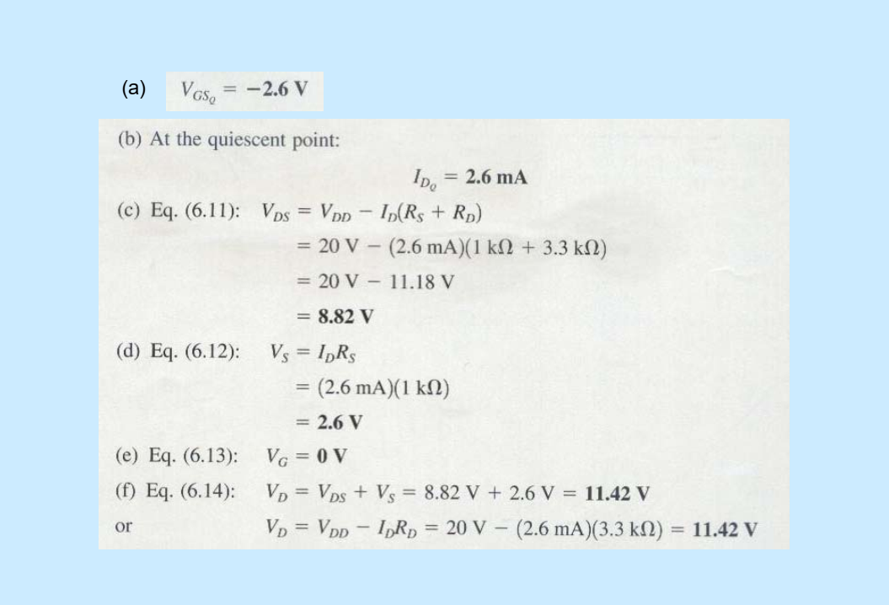

Slide 28
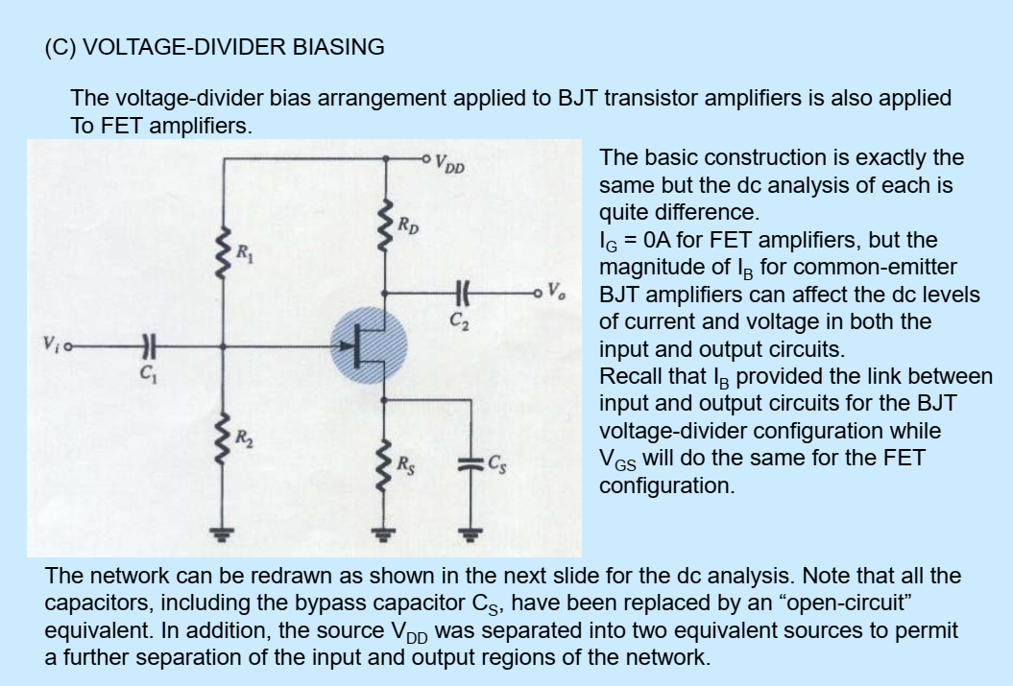

Slide 29
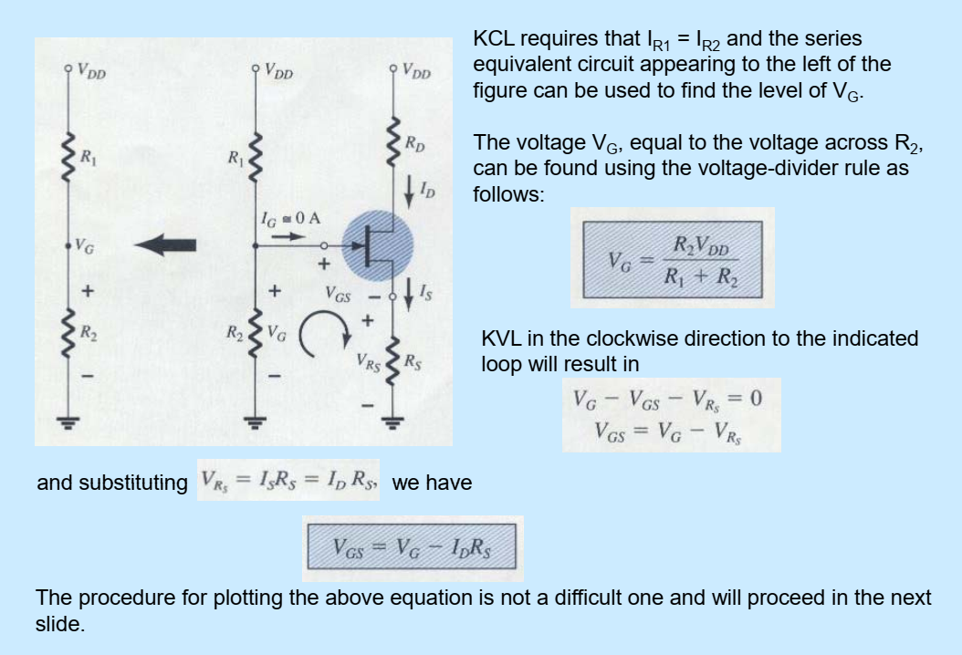

Slide 30


Slide 31
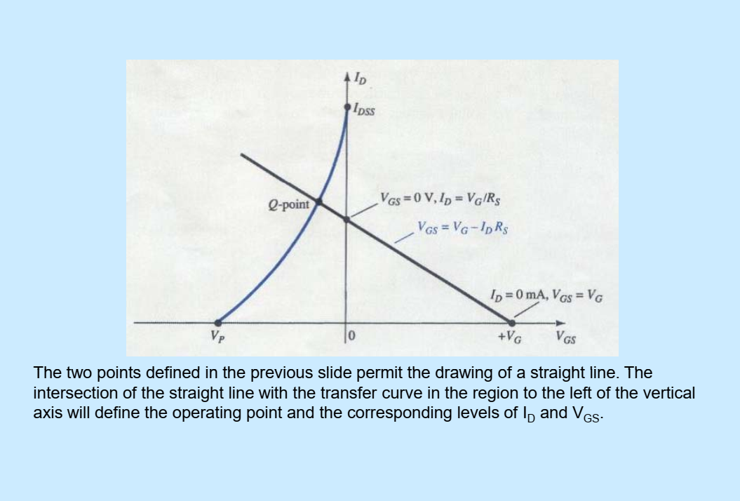

Slide 32
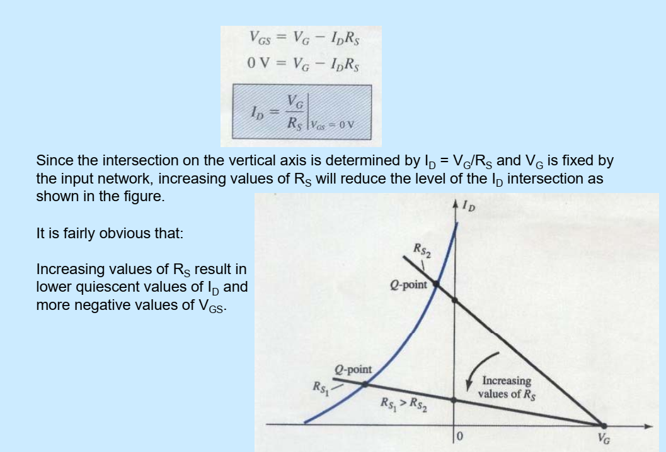

Slide 33
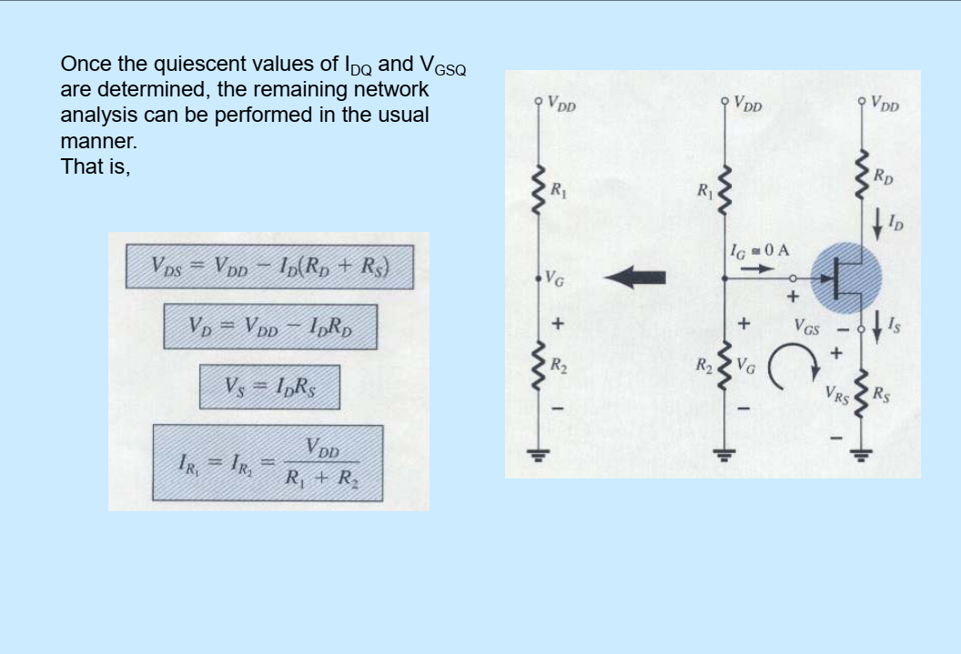

Slide 34
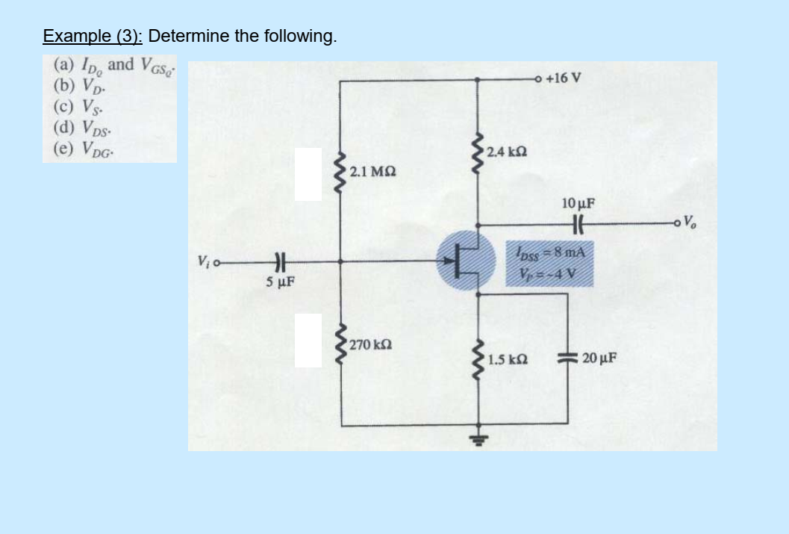

Slide 35
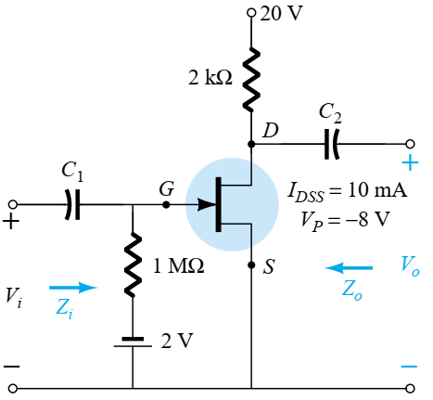
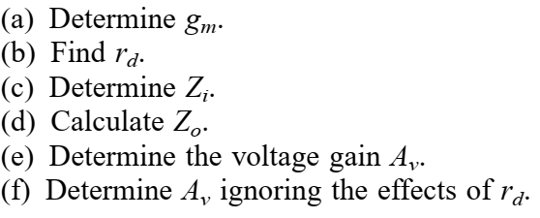
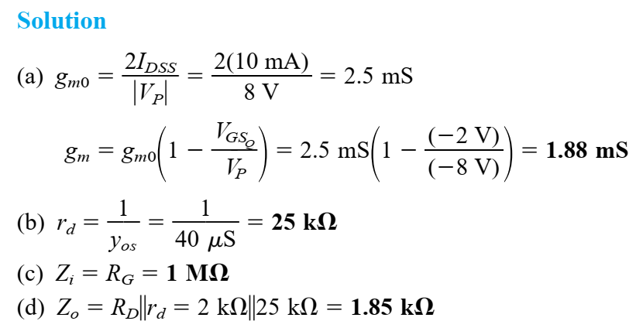
The fixed-bias configuration of had an operating point defined by VGSQ = - 2 V and IDQ = 5.625 mA, with IDSS =10 mA and VP = - 8 V. The network is redrawn as Fig. with an applied signal Vi. The value of yos is provided as 40 S.

Slide 36
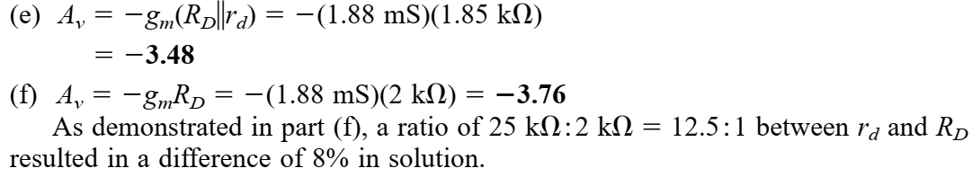

Slide 37
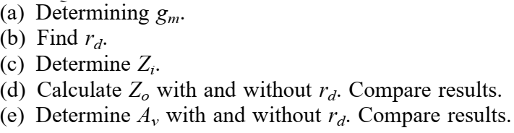
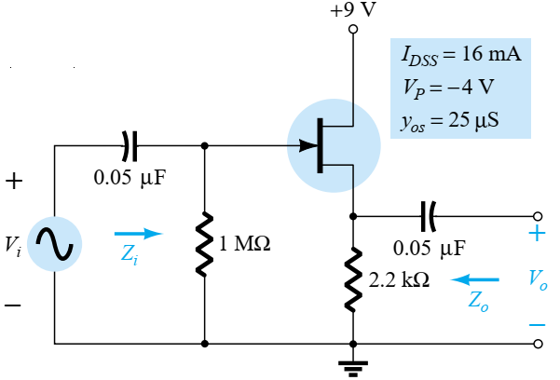
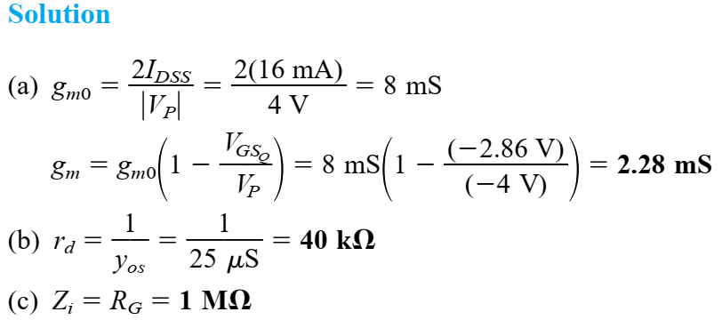
A dc analysis of the source-follower network of Fig. will result in V_{GSQ} = 2.86 V and I_{DQ} = 4.56 mA.

Slide 38
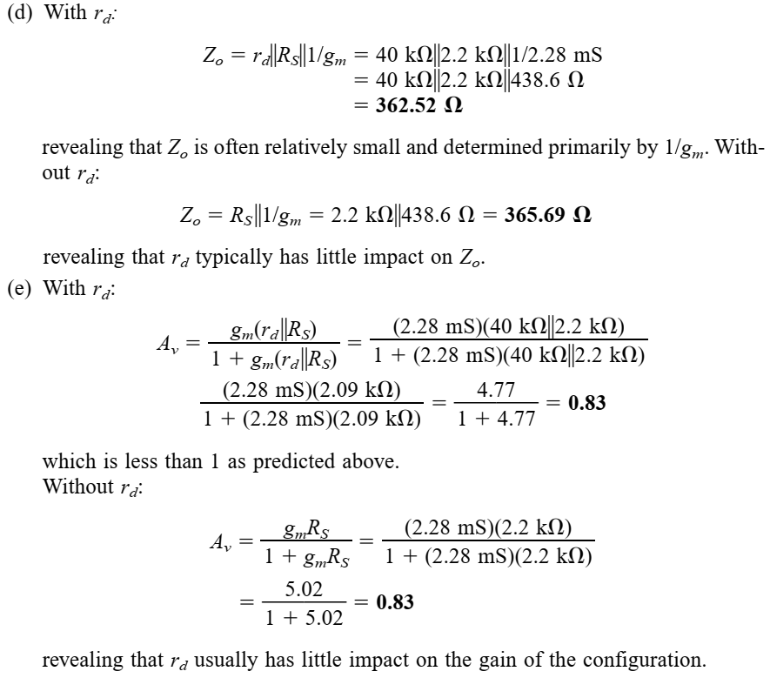

Slide 39
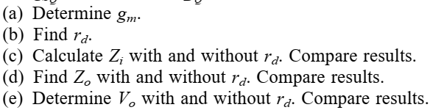
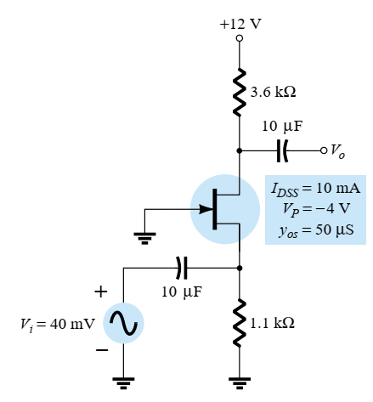
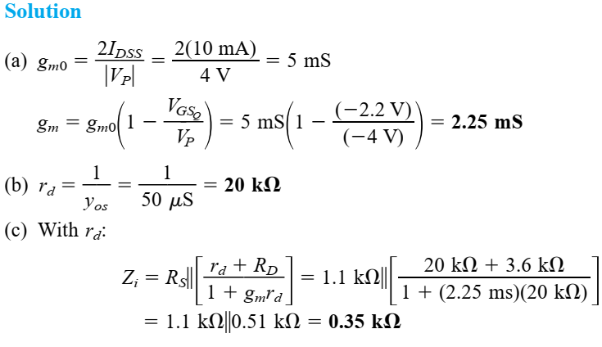
Although the network of Fig. 9.32 may not initially appear to be of the common-gate variety, a close examination will reveal that it has all the characteristics of Fig. 9.29. If VGSQ = -2.2 V and IDQ = 2.03 mA:

Slide 40
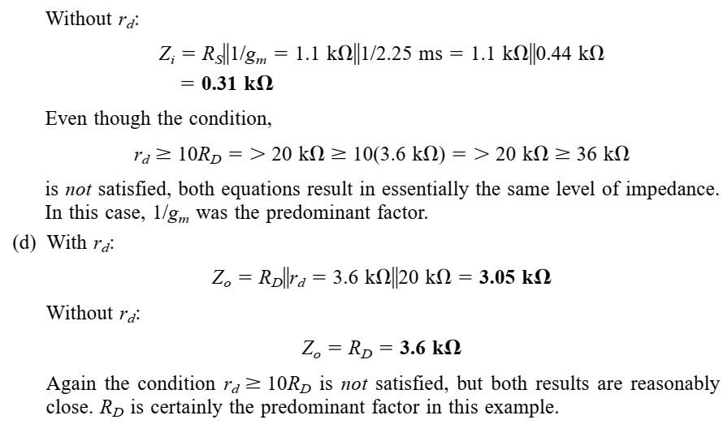

Slide 41
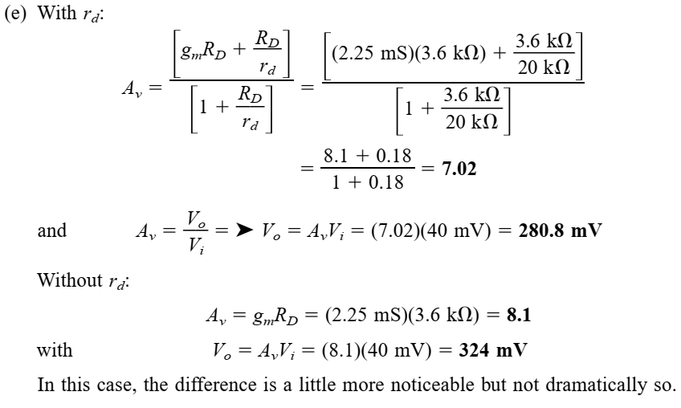

Slide 42
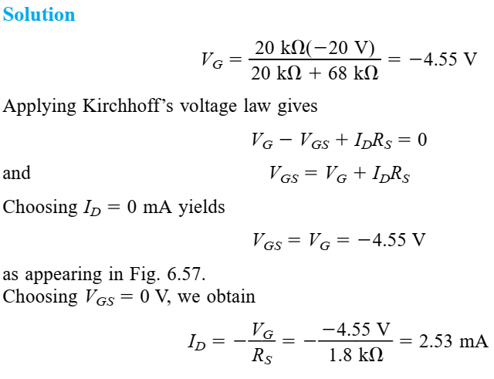
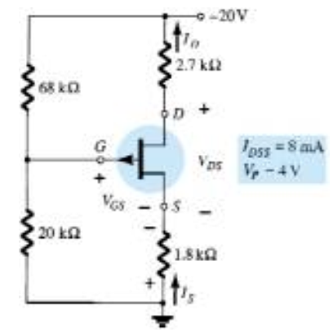
Determine IDQ, VGSQ, and VDS for the p-channel JFET of Fig.

Slide 43
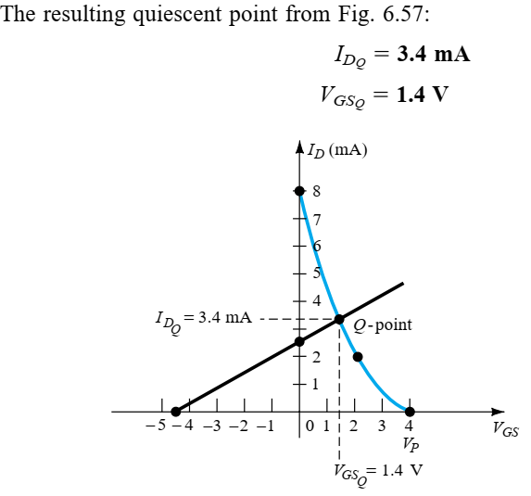
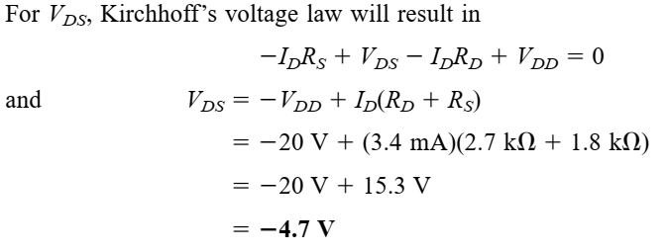

Slide 44
